Slide 1
Thunderstorm, lightening
and tornadoes

Slide 2
Thunderstorm
What is a thunderstorm? A thunderstorm is a storm with lightning and thunder. Its produced by a cumulonimbus cloud, usually producing winds, heavy rain and sometimes hail. What causes a thunderstorm? The basic ingredients used to make a thunderstorm are moisture, unstable air and lift.
You need moisture to form clouds and rain.
You need unstable air that is relatively warm and can rise rapidly.
Finally, you need lift. This can form from fronts, sea breezes or mountains.

Slide 3
FORMATION OF A THUNDERSTORM
Thunderstorms are created by large sections of warm, moist air rising into cool, dry air.
A cold front or convection in the atmosphere typically causes the warm air to rise and water vapor to condense.
All thunderstorms have 3 stages: cumulus, mature, and dissipating.

Slide 4
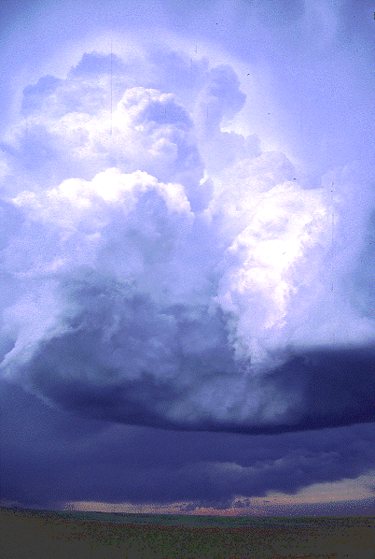
Cumulus Stage
There is no lighting or chance of tornado formation during this stage.
Heat from condensing water vapor in the cloud helps to fuel expanding and rising air.
The upward-moving air in this stage can approach speeds of 160 km/hr.

Slide 5
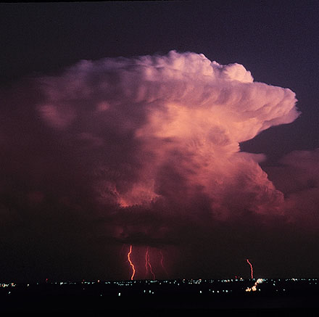
Mature Stage
As the warm moist air mass rises, the water vapor cools.
The water vapor condenses, (which releases more heat) saturates the cloud and produces torrential rains.
The falling rain pushes and pulls air downward with it, and the storm develops regions of fast moving downdrafts.
Simultaneously, rising warm air and falling colder air, causes large amounts of static electricity to be generated.

Slide 6
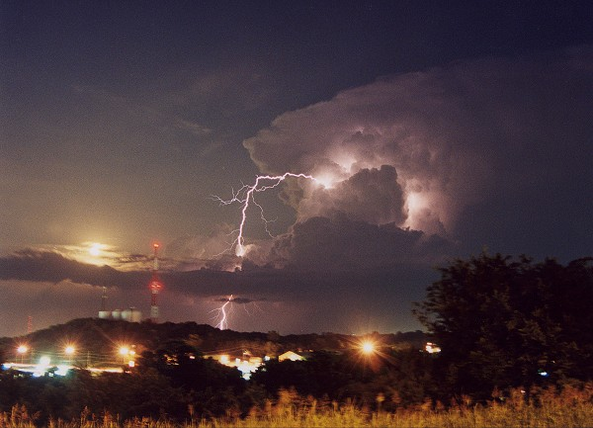
Mature Thunderstorms
Large, mature thunderstorms can
Produce precipitation at astonishing rates, up to 36cm/hr. This causes local flooding.
Create hailstones as large as grapefruits
Generate tremendous electrical power and intense lightning.
Produce tornadoes with devastating swirling winds

Slide 7
Dissipating Stage
Downbursts of high speed wind may occur.
All air within the storm has become cooler than the air outside of the storm.
If deprived of its energy source of warm, moist air, the storm soon splits into a series of disorganized layers of cloud and the storm is finished

Slide 8
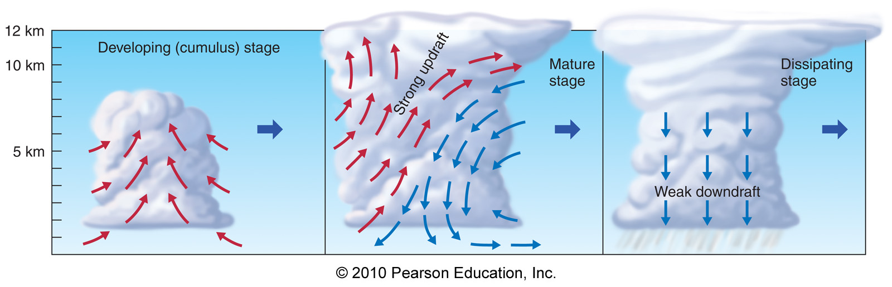
Developing (cumulus), mature and dissipating

Slide 9
When are thunderstorms most likely to occur? Thunderstorms can occur year-round and at all hours. But they are most likely to happen in the spring and summer months and during the afternoon and evening hours. How many thunderstorms are there every day? It is estimated that there are around 1,800 thunderstorms that occur across our planet every day. Are thunderstorms, dangerous? Yes, despite their small size thunderstorms are dangerous. Every thunderstorm produces lightning, which kills more people each year than tornadoes.

Slide 10
LIGHTNING
Lightning is the rapid movement of electric energy from one part of a cloud to another or to the ground.
Lightning occurs when positive and negative charges build up in different regions of a cumulonimbus cloud.
Large raindrops become charged by friction as they fall through the cloud. The top of the cloud becomes positively charged.
The bottom of the cloud becomes negatively charged
All thunderstorms produce lightning and are very dangerous. If you hear the sound of thunder, then you are in danger from lightning. Lightning kills and injures more people each year than hurricanes or tornadoes; between 75 to 100 people.

Slide 11
What causes lightning?
Lightning is an electric current. Within a thundercloud way up in the sky, many frozen raindrops bump into each other as they move around in the air. All of those collisions create an electric charge.
After a while, the whole cloud fills up with electrical charges. The positive charges or protons form at the top of the cloud and the negative charges or electrons form at the bottom of the cloud. Since opposites attract, that causes a positive charge to build up on the ground beneath the cloud. The grounds electrical charge concentrates around anything that sticks up, such as mountains, people, or single trees. The charge coming up from these points eventually connects with a charge reaching down from the clouds and - zap - lightning strikes!

Slide 12
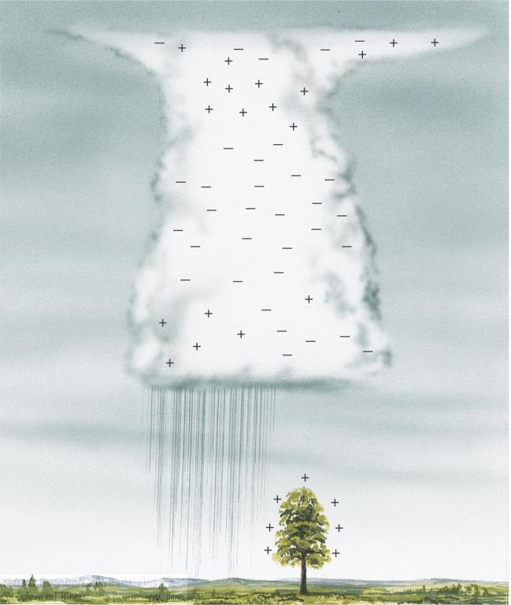

Slide 13
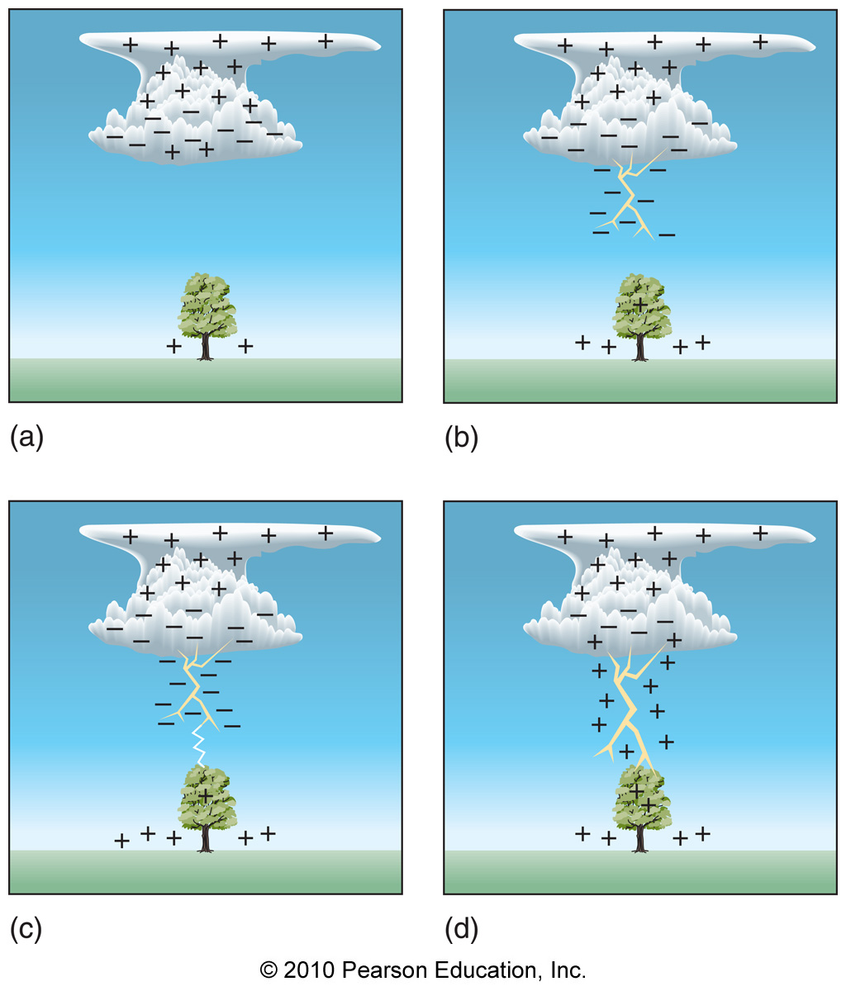
Development
of lightning

Slide 14
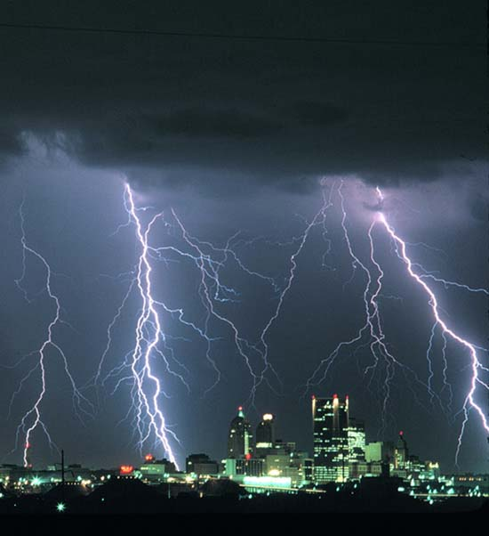

Slide 15
Lightening harmful?
Lightning is responsible for more deaths annually than tornadoes and hurricanes combined.
It causes fires
Lightning is very hot, nearly 5 times as hot as the surface of the sun!

Slide 16
Lightning
Light from a lightning travels very fast about 300,000 kilometers/sec
Sound travels much more slowly about 340 meters/ sec
This is why you see the flash before the thunder is heard.
The smaller the interval between seeing lightning and hearing the sound of thunder, the closer you are to the lightning.

Slide 17
What is the approximate distance of thunderstorm when you note a 3 second delay between the flash of the lightning and the sound of the thunder?
Answer: 3 seconds × 340 meters/second
= 1020 meters

Slide 18
What causes thunder? Thunder is caused by lightning. When a lightning bolt travels from the cloud to the ground it actually opens up a little hole in the air, called a channel. Once then light is gone the air collapses back in and creates a sound wave that we hear as thunder. The reason we see lightning before we hear thunder is because light travels faster than sound! How do you know if lightning is nearby? If you see dark clouds, then lightning could be present, but the best thing you can do is to listen for thunder. If you hear thunder, then you need to go indoors or get in a car. Don't be outside, where lightning could strike! If your hair stands on end or your skin starts to tingle, lightning maybe about to strike. Get down on your hands and knees and keep your head tucked in. Do not lay flat, because it can give lightning a better chance of strike you. How far away can you see lightning and hear thunder? Within those distant thunderstorms, the lightning bolts can be seen as much as 100 miles from us, depending on the height of the bolt, the clarity of the air, and our elevation.
Thunder, in comparison, has a much shorter range of detection - usually less than 15 miles in a quiet rural setting and under 5 miles in a noisy city environment.

Slide 19


Can you tell how far away a storm is? Yes, you can use thunder to tell how far away a storm is. Next time you see a storm, count the number of seconds between when you see the lightning and hear the thunder. Take the number of seconds and divide by 5 and that will tell you how far away the storm is in miles. For example: If you counted 10 seconds between the lightning and the thunder, the lightning is 2 miles away! What is hail? Hail is created when small water droplets are caught in the updraft of a thunderstorm. These water droplets are lifted higher and higher into the sky until they freeze into ice. Once they become heavy, they will start to fall. If the smaller hailstones get caught in the updraft again, they will get more water on them and get lifted higher in the sky and get bigger. Once they get lifted again, they freeze and fall. This happens over and over again until the hailstone is too heavy and then falls to the ground.

Slide 20
Tornado

Slide 21
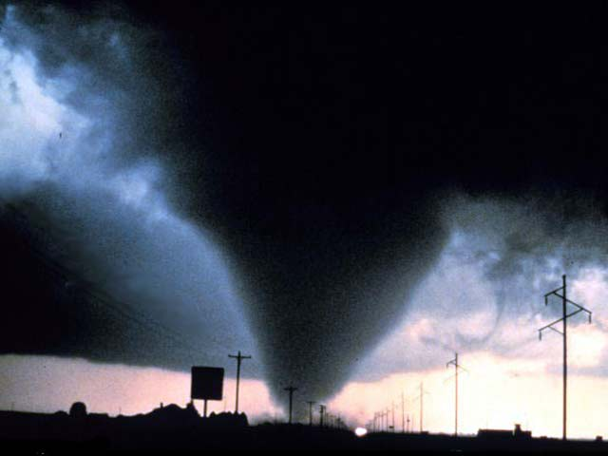
What is a tornado?
A tornado is a violent rotating column of air extending from a thunderstorm to the ground. The most violent tornadoes are capable of huge destruction with wind speeds of up to 300 mph. They can destroy large buildings, uproot trees and hurl vehicles hundreds of yards. They can also drive straw into trees. Damage paths can be in excess of one mile wide to 50 miles long.

Slide 22
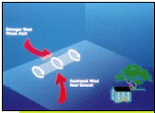
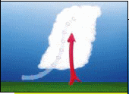
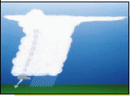
How do tornadoes form? Most tornadoes form from thunderstorms. You need warm, moist air from the Gulf of Mexico and cool, dry air from Canada. When these two air masses meet, they create instability in the atmosphere.
A change in wind direction and an increase in wind speed with increasing height creates an invisible, horizontal spinning effect in the lower atmosphere. Rising air within the updraft tilts the rotating air from horizontal to vertical. An area of rotation, 2-6 miles wide, now extends through much of the storm. Most strong and violent tornadoes form within this area of strong rotation.

Slide 23
Different factors for tornadoes formation Several conditions are required for the development of tornadoes and the thunderstorm clouds with which most tornadoes are associated.
Abundant low level moisture is necessary to contribute to the development of a thunderstorm, and a "trigger" (perhaps a cold front or other low level zone of converging winds) is needed to lift the moist air aloft.
Once the air begins to rise and becomes saturated, it will continue rising to great heights to produce a thunderstorm cloud, if the atmosphere is unstable. An unstable atmosphere is one where the temperature decreases rapidly with height.
Atmospheric instability can also occur when dry air overlays moist air near the earth's surface.
Finally, tornadoes usually form in areas where winds at all levels of the atmosphere are not only strong, but also turn with height in a clockwise or veering direction. What do tornadoes look like? Tornadoes can appear as a traditional funnel shape, or in a slender rope-like form.

Slide 24
How do tornadoes stop? It is not fully understood about how exactly tornadoes form, grow and die. Tornado researchers are still trying to solve
What is a supercell thunderstorm? A supercell thunderstorm is a long-lived thunderstorm whose updrafts and downdrafts are in near balance. These storms have the greatest tendency to produce tornadoes that stay on the ground for long periods of time. Supercell thunderstorms can produce violent tornadoes with winds exceeding 200 mph.

Slide 25
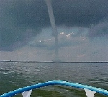
What is a waterspout? A waterspout is just a weak tornado that forms over water. They are most common along the Gulf Coast. Waterspouts can sometimes move inland, becoming tornadoes causing damage and injuries.

Slide 26
When are tornadoes most likely to occur? Tornadoes can happen at any time of the year and at any time of the day. In the southern states, peak tornado season is from March through May. Peak times for tornadoes in the northern states are during the summer. A few southern states have a second peak time for tornado outbreaks in the fall. Where are tornadoes most likely to occur? The geography of the central part of the United States, known as the Great Plains, is suited to bring all of the ingredients together to forms tornadoes. More than 500 tornadoes typically occur in this area every year and is why it is commonly known as "Tornado Alley". Texas, Oklahoma, Kansas, Nebraska, South Dakota, North Dakota, Iowa, Missouri, Arkansas and Louisiana all make up Tornado Alley.

Slide 27
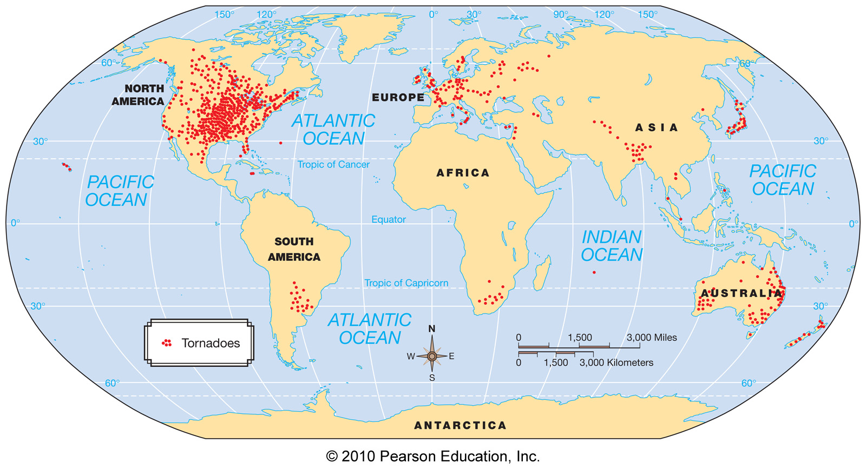
Global tornado frequency
[insert fig 11-32]
Notes:
27

Slide 28
Difference between tornadeos and cyclones
Tornadoes can be up to 4km across, and are usually no more than a few hundred meters wide, while Tropical cyclones are hundreds of kilometers across.
Tornadoes only last a few minutes, whereas Tropical Cyclones last several days, maybe even a week.
Tornado wind speeds typically range from 63 to 177km/h , cyclones speed can exceed 480km/h. When wind speeds of a tropical cyclone are between 63km/h and 118km/h they are called tropical storms, when the speed reaches 119km/h, they are called hurricanes, typhoons, or intense tropical cyclones depending on the region.
Tropical Cyclones form over sea then may travel over land, while Tornadoes form primarily over land. When Tornadoes form over seas, they are called waterspouts.
Tornadoes are formed when wind shear sets thunderstorms rotating, and that rotation then tightens, intensifies, and extends to the ground. A Tropical Cyclone is formed when an area of low pressure moves over warm ocean water. The moisture feeds into the system causing it to intensify. An effect called the 'Coriolis effect' causes it to rotate in a clockwise or anticlockwise direction, depending on whether your in the southern or northern hemisphere, and as a result become better organized

